Slide 1
PYTHON {DATA ANALYTICS}
CEIS110|FINAL COURSE PROJECT
By: Jessica Esparza
Introduction to Programming
DeVry University

Slide 2
INTRODUCTION
This course project covers data analysis using python, resulting in an analysis of weather data downloaded from a cloud data source, stored in a database, extracted and processed. The design and development process of the system will include planning, software setup, programming, and data analysis. Programming and data analytics will be utilized to analyze data and develop charts and predictions.

Slide 3
DESIGN & LIBRARY SETUP
{Objectives}
To use a flowchart as a design tool
To develop a flowchart for the course project
To generate a prototype design of a software system
To install necessary python libraries

Slide 4
FLOWCHART
Start
End
Cleanse weather data
Extract weather data from database into a csv file with python
Use Excel to manipulate data
Use python data analytics modules to develop graphical models
Download weather data to a database
Install Python Module
INCLUDE THE FOLLOWING PROCESSES:
INSTALL PYTHON
DOWNLOAD WEATHER DATA TO A DATABASE.
EXTRACT WEATHER DATA FROM DATABASE INTO A COMMA SEPARATED FILE WITH PYTHON
CLEANSE WEATHER DATA
USE EXCEL TO MANIPULATE DATA
USE PYTHON DATA ANALYTICS MODULES TO DEVELOP GRAPHICAL MODELS

Slide 5
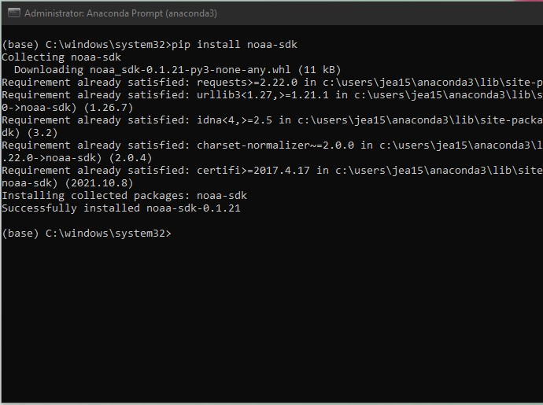
SOFTWARE INVENTORY
Include screenshot of NOAA-SDK library installed
Ensure result "Successfully installed noaa-sdk" of pip install command is visible in your screenshot.

Slide 6
DOWNLOADING WEATHER DATA
{Objectives}
To learn how to use Python data analytics modules
To compare data at different times.
Use data analytics to interpret and analyze data from a database

Slide 7
BUILDWEATHERDB.PY CODE
Screenshot of code in Spyder with name and date in comments. Must have your zip code

Slide 8
PYTHON CONSOLE
Screenshot of program output in Python console showing program executed successfully

Slide 9
WEATHER.DB FILE
Screenshot of Windows Explorer showing database file Weather.db was created

Slide 10
QUERYING THE DATABASE WITH SQL
{Objectives}
To connect to a database using Python
To execute a simple SQL SELECT query
To view data retrieved from the database using a query

Slide 11
QUERY TO RETRIEVE ALL COLUMNS & ALL ROWS

Slide 12
QUERY TO RETRIEVE LOWEST & HIGHEST TEMPERATURES

Slide 13
QUERY TO RETRIEVE ALL CLEAR DAYS

Slide 14
QUERYING & MANIPULATING DATA WITH SQL & PYTHON
{Objectives}
To retrieve data from a database with an embedded SQL query in Python
To cleanse data and manipulate data from a database in Python
To save data as a CSV file
To open data in Excel and create a chart

Slide 15
PYTHON CODE
ExtractTempHumidity.py Python code with your name and date in comments

Slide 16
Retrieve & Convert Data to CSV
Format data file open in Excel showing 3 columns of data

Slide 17
Temperature & Humidity Chart
Excel chart based on temperature and humidity data from database

Slide 18
DEVELOP GRAPHICAL MODELS & INTERPRET RESULTS
{Objectives}
To learn how to use Python data analytics modules
To compare data at different times
Use data analytics to interpret and analyze data from a database

Slide 19
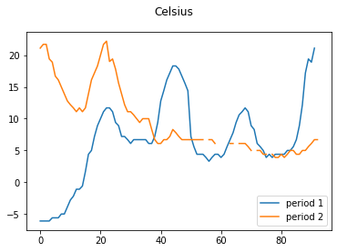
PLOT #1

Slide 20
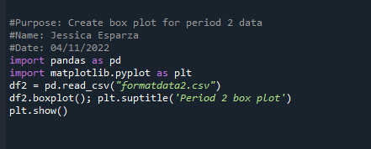
PLOT #2

Slide 21
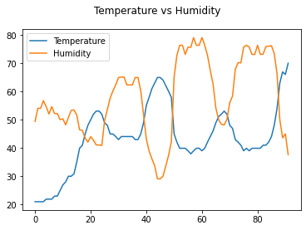
ANALYSIS
Think of your own question and create a chart/graph to answer it
Your own question:
What happens to the humidity when the temperature falls?
Answer supported by Chart: Humidity increases whenever there is a drop in temperature.

Slide 22
PREDICTION
Develop a prediction based on the data. What variations in temperature and humidity do you expect over the next few hours or days? How would humidity change if temperature goes up or down?
Based on the data compiled, humidity is expected to increase whenever there is a decrease in temperature, as the two appear to have an inverse relationship.

Slide 23
CHALLENGES
As I learned Python throughout this course, avoiding common syntax errors (such as missing commas & unclosed parentheses or brackets) was the biggest challenge I faced. With regular practice, I’ll be able to catch my mistakes early-on and minimize errors when executing my code. After all, learning a new language is never an easy task.

Slide 24
CAREER SKILLS
Important career skills I have gained include the following:
Understanding of the basics of programming logic
Understanding of the software development process & software development tools
Analysis, manipulation, & interpretation of data from a database (using Python data analytics modules)
Error handling & debugging to track down logic errors in Python code

Slide 25
CONCLUSION
At first, I had very little experience with the python programming language. Throughout the course, I gained a better understanding of object-oriented programming and the software development process. This introduction has given me the confidence to continue learning and building the fundamental programming skills I need to be successful.

